Slide 1
MONOPOLISTIC COMPETITION AND MONOPOLIES
MGCR 293
Professor: Kamal Salmasi
Taweewan Sidthidet
Tariq Nizami
T.A.: Mike Brintnell
Presentation Credit: Brianna Mooney

Slide 2
CHAPTER REVIEW

Slide 3
MONOPOLISTIC COMPETITION

Slide 4

MONOPOLISTIC COMPETITION
Many firms
Differentiated goods
Low barriers to entry
Firms are no longer price-takers. Demand is price elastic but not perfectly elastic.
https://www.youtube.com/watch?v=8a3gXThQeK0

Slide 5
MONOPOLISTIC COMPETITION -- MARKET POWER
Firms have more market power (control over price) than under perfect competition due to their differentiated goods/services. However, given the intense competition, any one firm does not have significant market power.
Firms compete significantly on non-price product attributes (ex: product quality)

Slide 6
MONOPOLISTIC COMPETITION
The demand curve for a monopolistically competitive firm is downward-sloping, as is the Marginal revenue curve
Trick: the MR curve is found by doubling the slop of the D curve, and keeping the same y-intercept

Slide 7
SHORT-RUN EQUILIBRIUM
It is possible to make economic profit
Look at where MR=MC
Trace that quantity to D curve to determine the associated P
Trace that quantity to ATC to determine the associated ATC.
Profit = TR –TC = P(Q) – ATC(Q) → the yellow rectangle

Slide 8
LONG-RUN EQUILIBRIUM
Since there are low barriers to entry, firms may enter and exit the industry easily
When firms in the industry are earning economic profit, this entices new firms to enter the industry. As new firms enter the industry, the demand for each firm’s product decreases. This is resembled as a leftward shift of the firm’s demand curve (and therefore the MR curve also shifts left)
When other firms leave the industry, demand curve(and the MR curve) shifts right

Slide 9
LONG RUN EQUILIBRIUM

Slide 10
LONG RUN EQUILIBRIUM
Due to the low barriers to entry, there is no potential for economic profit in the long-run
Profit maximizing output will be where MR=MC. At this output, P=AC → no economic profit

Slide 11
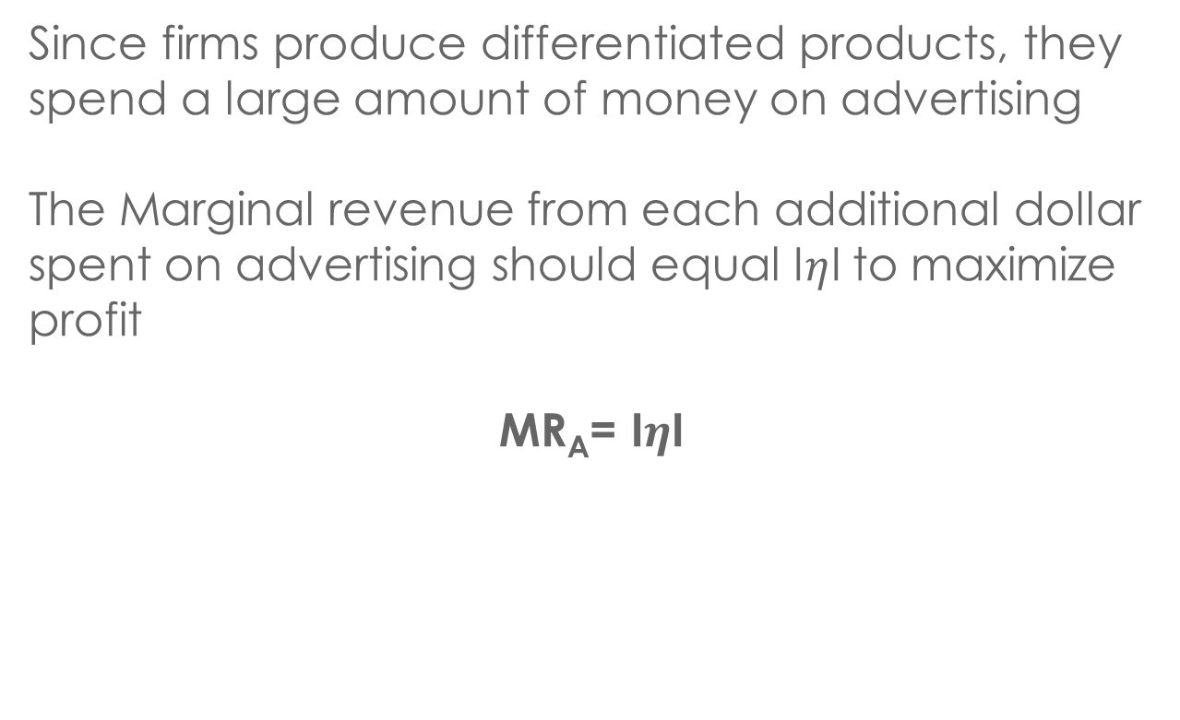
OPTIMAL ADVERTISING
Since firms produce differentiated products, they spend a large amount of money on advertising
The Marginal revenue from each additional dollar spent on advertising should equal I$η$I to maximize profit
MR_{A}= I$η$I

Slide 12
OPTIMAL ADVERTISING
Marginal revenue from an extra dollar of A (1)
Absolute Value of Price Elasticity OR Marginal Revenue
Marginal revenue from an dollar $ of A (2)
Absolute Value of Price Elasticity of Demand
R
S
Advertising Expenditure

Slide 13
MONOPOLY

Slide 14
MONOPOLY
Single Supplier
High Barriers to Entry (legal or natural)
Price Setter
No Close Substitutes

Slide 15
MARKET POWER
Monopolies have full market power, and are thus able to set the price of their product.

Slide 16
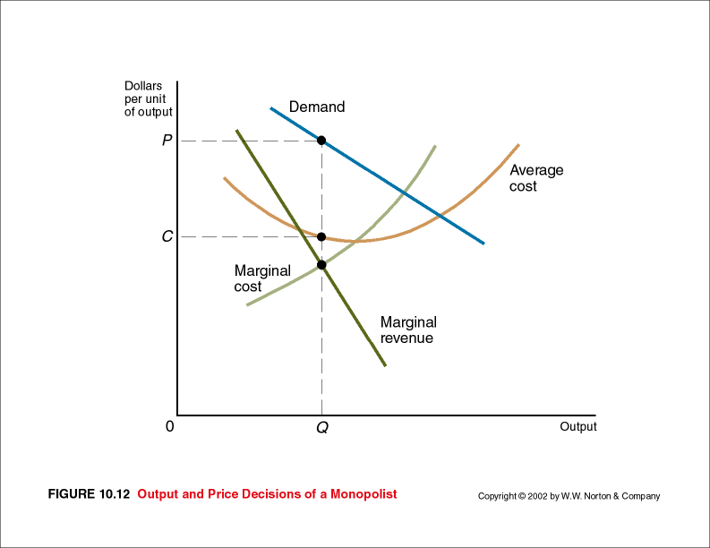
MONOPOLY
Monopolies have downward sloping demand curves. Profit maximizing output is where MR – MC. Note that in the long-run, monopolies can continue to earn an economic profit

Slide 17
Cost-Plus Pricing
Monopolies may use cost-plus pricing to cover hard to allocate costs and to provide a return on the firm’s investment
Price = Cost (1+Markup)
It does not necessarily optimize profit
Profit maximizing markup:
Markup = -1/(η +1)

Slide 18
MONOPOLY
When a firm makes more than one product, a change in the price and quantity sold of one of its products may influence the demand for its other products:
TR = TR_{X} + TR_{Y}
TR_{X} is total revenue from product X, and TR_{Y} is total revenue from product Y
The marginal revenue of each product :
MR_{X} = dTR/dQ_{X} = dTR_{X}/dQ_{X} + dTR_{Y}/dQ_{X}
MR_{Y}= dTR/dQ_{Y} = dTR_{X}/dQ_{Y} + dTR_{Y}/dQ_{Y}

Slide 19
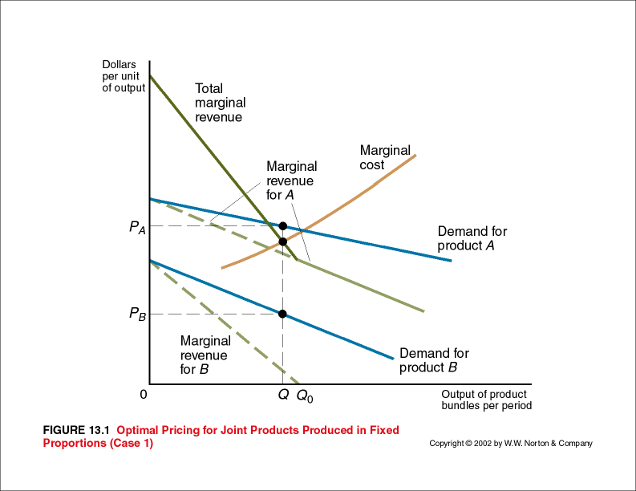
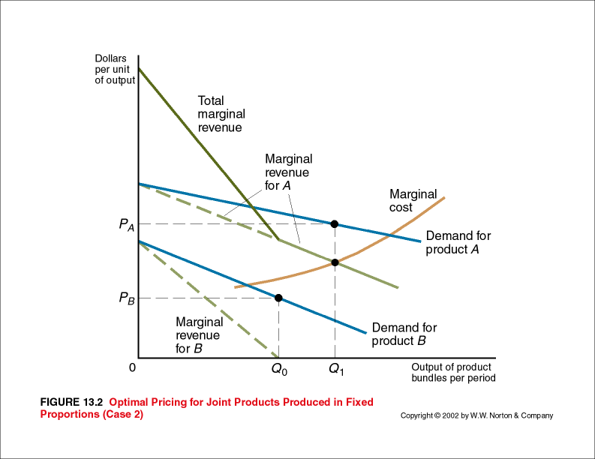
MONOPOLY PRODUCE JOINT PRODUCTS IN FIXED PROPORTIONS

Slide 20
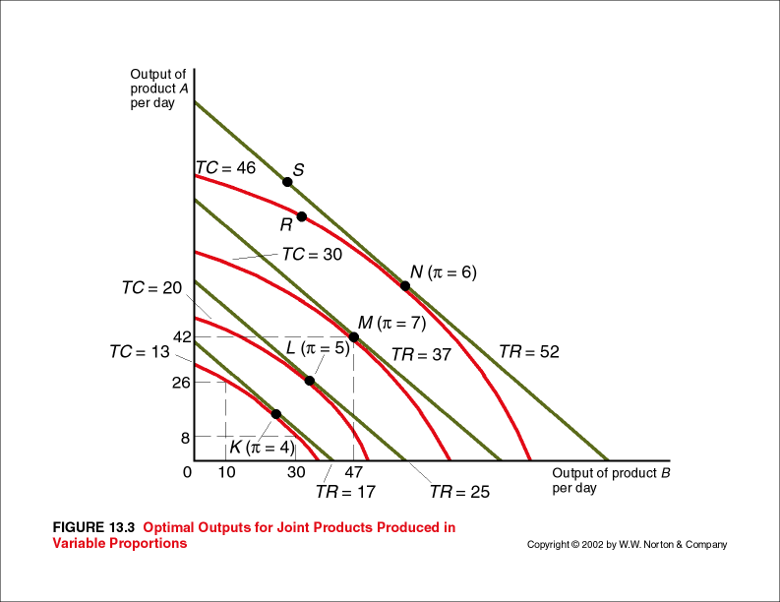
MONOPOLY PRODUCE JOINT PRODUCTS IN VARIABLE PROPORTIONS
Isocost curve: Curve showing the different combinations of goods produced at the same total cost.
Isorevenue lines: Lines showing the combinations of output of products that yield the same total revenue.

Slide 21
CHAPTER QUESTIONS

Slide 22
QUESTION 1
Metal-producing firm that is an unregulated monopoly
MR = 100-2Q MC = 60+2Q
a) If Smith wants to maximize profit, what output should he choose?
b) What price should he charge?

Slide 23
SOLUTION 1
a) MR=MC
100-2Q=60+2Q, Q=10
b) P=100-Q, P=100-10
P=$90

Slide 24
QUESTION 2
The price elasticity of demand for its product equals -2.2. According to studies she carried out, the relationship between the amount spent by the firm on advertising and its sales is as follows:
Advertising Expenditure | Sales
$100,000 | $1.0 million
$200,000 | $1.3 million
$300,000 | $1.5 million
$400,000 | $1.6 million

Slide 25
QUESTION 2
If the Wilson Company spends $200,000 on advertising, what is the marginal revenue from an extra dollar of advertising?
Is $200,000 the optimal amount for the firm to spend on advertising?

Slide 26

SOLUTION
A) MR_{A}= $\frac{1,300,000−1,000,000}{200,000−100,000}$ = $3.00
B) Since MR=$3.00 and the n=2.2 then this is not optimal

Slide 27
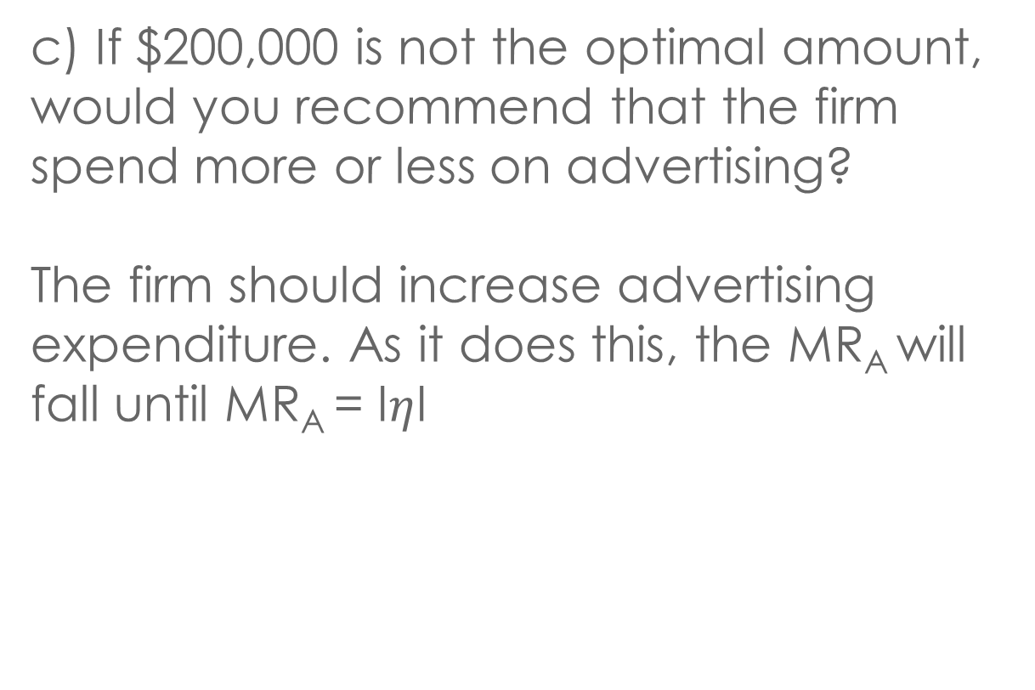
SOLUTION
c) If $200,000 is not the optimal amount, would you recommend that the firm spend more or less on advertising?
The firm should increase advertising expenditure. As it does this, the MR_{A} will fall until MR_{A} = I$η$I

Slide 28
QUESTION 3
The Coolidge Corporation is the only producer of a particular type of laser. The demand curve of its product is:
Q=8300-2.1P
and its total cost function is:
TC = 2200+480Q+20Q²
a) Derive and expression for the firm’s marginal revenue curve

Slide 29
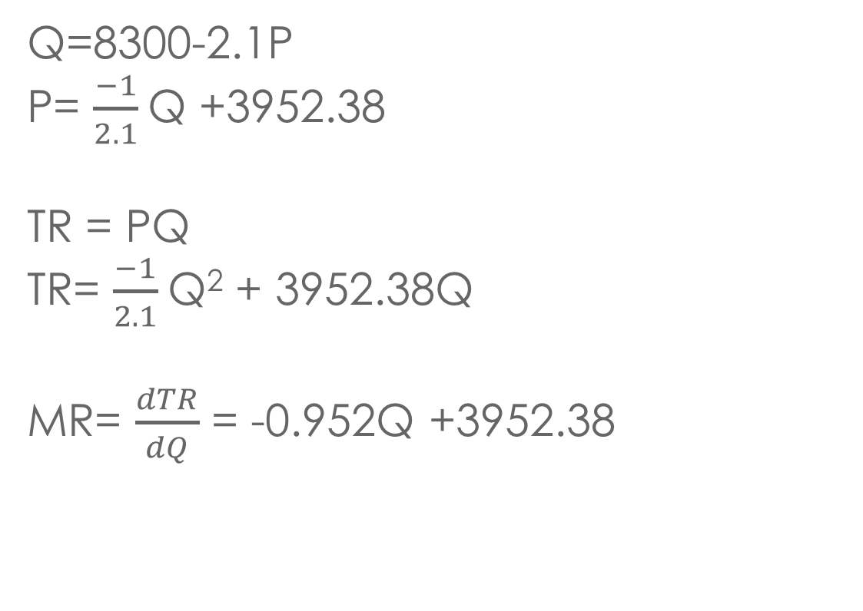
SOLUTION
Q=8300-2.1P
P= $\frac{−1}{2.1}$Q +3952.38
TR = PQ
TR= $\frac{−1}{2.1}$Q² + 3952.38Q
MR= $\frac{dTR}{dQ}$ = -0.952Q +3952.38

Slide 30
QUESTION 3
b) To maximize profit, how many lasers should the firm produce and sell per month?
c) If this number were produced and sold, what would be the firm’s monthly profit?

Slide 31
SOLUTION
b) MC=MR
480+40Q = 3952 - 0.952Q
Q=84.8 → P=3952 - 0.476(84.8)=$3,912
c) Π = TR-TC = 84.8(3912) – [2200 + 480(84.8) + 20(84.8)²] = $145,012.80

Slide 32
QUESTION 4
The Madison Corporation has a demand function for its products is:
Q = 78 – 1.1P + 2.3Y + 0.90A
Q is the number of units sold, P is the price of its product (in dollars), Y is per capita income (in thousands of dollars), and A is the firm’s advertising expenditure (in thousands of dollars).
AVC=42 – 8Q +1.5Q²

Slide 33
QUESTION 4
Can we determine the firm’s marginal cost curve?
b) Can we determine the firm’s marginal revenue curve?

Slide 34
SOLUTION
TVC= Q x AVC
TVC= 42Q - 8Q²+ 1.5Q³
Therefore, MC=42-16Q+4.5Q²
b) 1.1P=78 + 2.3Y +0.9A – Q
P=(78 + 2.3Y +0.9A – Q)/1.1
TR=[(78 + 2.3Y +0.9A – Q)/1.1]Q
MR= (78-2Q+2.3Y+.9A)/1.1

Slide 35
c) If per capita income is $4,000 and advertising expenditure is $200,000, can we determine the price and output where marginal revenues equal marginal cost? If so, what are they?

Slide 36
SOLUTION
c) MR=(78-2Q+2.3Y+.9A)/1.1
MR=[78-2Q+2.3(4)+.9(200)]/1.1=242.9 – 1.81Q
MR=MC
242.9 – 1.81Q = 42 – 16Q +4.5Q²
Q=8.44 and P=235.24

Slide 37
QUESTION 5
The Wilcox Company has two plants with the marginal cost functions: MC₁ = 20 + 2Q₁
MC₂ = 10 + 5Q₂
If the Wilcox Company minimizes its costs and produces five units of output in the first plant, how many units of output does it produce in the second plant? Explain.

Slide 38
SOLUTION
MC₁=20 +2Q₁
MC₂=10 +5Q₂
MC₁= MC₂
20 +2(5)=10 +5Q₂
Q₂=4
The firm has to have the MC of both product equal to each other

Slide 39
QUESTION 5
b) What is the marginal cost function for the firm as a whole?
c) Can we determine from these data the average cost function for each plant? Explain.

Slide 40
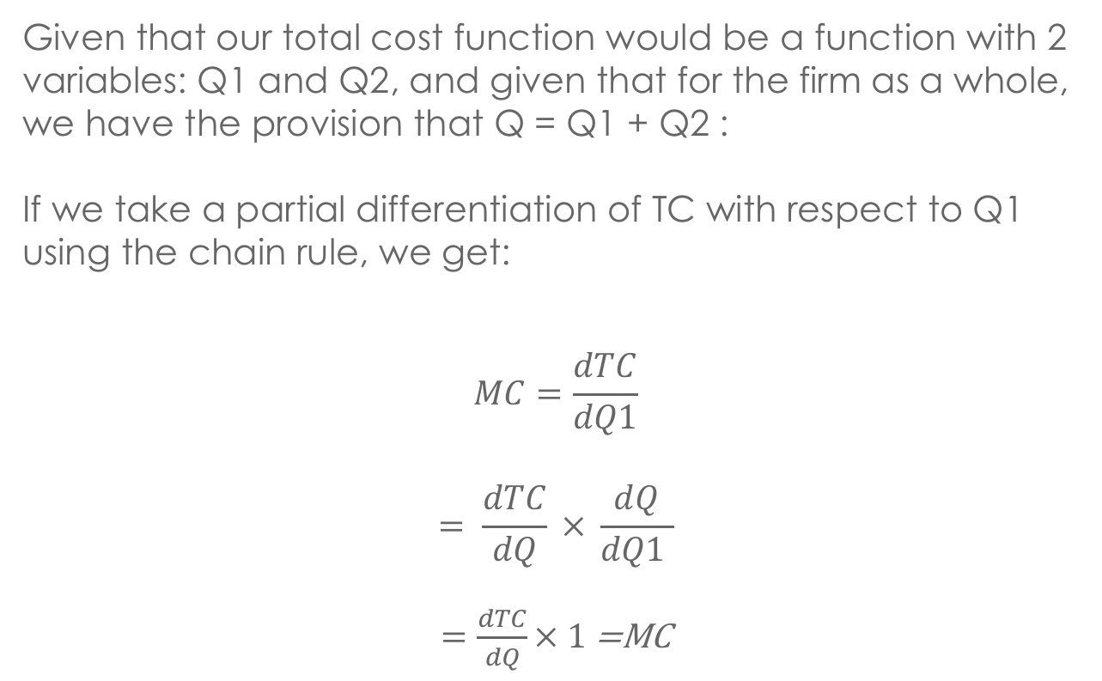
SOLUTION
Given that our total cost function would be a function with 2 variables: Q1 and Q2, and given that for the firm as a whole, we have the provision that Q = Q1 + Q2 :
If we take a partial differentiation of TC with respect to Q1 using the chain rule, we get:
$$MC=\frac{dTC}{dQ1}$$
$$= \frac{dTC}{dQ} × \frac{dQ}{dQ1 }$$
$=\frac{dTC}{dQ}× 1$ =MC
dQ/dQ1 = 1

Slide 41
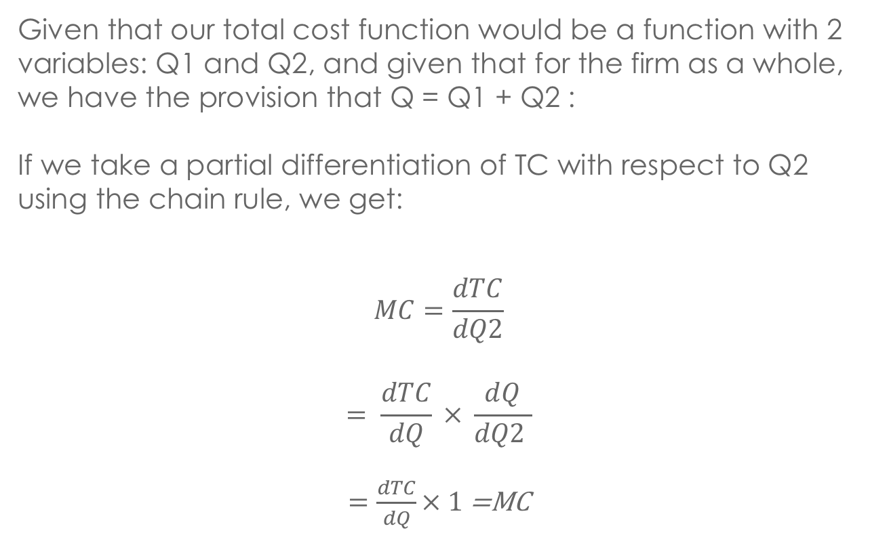
SOLUTION
Given that our total cost function would be a function with 2 variables: Q1 and Q2, and given that for the firm as a whole, we have the provision that Q = Q1 + Q2 :
If we take a partial differentiation of TC with respect to Q2 using the chain rule, we get:
$$MC=\frac{dTC}{dQ2}$$
$$= \frac{dTC}{dQ} × \frac{dQ}{dQ2 }$$
$=\frac{dTC}{dQ}× 1$ =MC
dQ/dQ2 = 1

Slide 42
SOLUTION
Therefore, since dTC/Q1 = MC and dTC/Q2 = MC, the MC for the firm must equal MC1 = MC2
This also indicates that cost minimization occurs when MC1 =MC2, because if TC is minimized, MC1 = 0 = MC2

Slide 43
SOLUTION
MC= MC₁= MC₂
Q₁=(MC₁/2) – 10, Q₂=(MC₂/5) – 2
Q= Q₁+ Q₂ → Q=0.7MC – 12
MC = Q + 12/0.7
c) No, because we do not have information concerning the fixed costs of each plant. But we can determine average variable cost.

Slide 44
QUESTION 6
If the Rhine Company ignores entry, it should set a price of $10,000 for its products.
But if it does so, other firms will begin to enter the market. During the next two years it will earn $ 4 million per year, but in the following two years it will earn $1 million per year. On the other hand, if it sets a price of $7,000, it will earn $2.5 million in each of the next four years because no entrant will appear.

Slide 45
QUESTION 6
If the interest rate is 10%, what price should the company set? Why?
SOLUTION: LOOK AT PRESENT VALUE

Slide 46
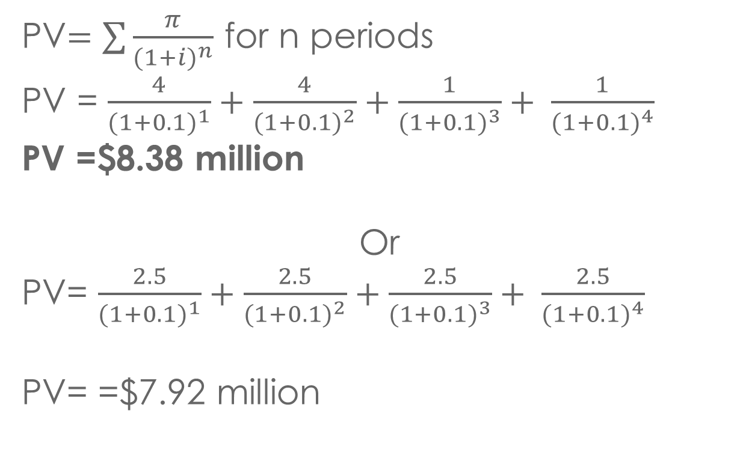
SOLUTION
PV$=\sum{\frac{π}{{(1+i)}^{n}}}$ for n periods
PV = $\frac{4}{{(1+0.1)}^{1}}+\frac{4}{{(1+0.1)}^{2}}+\frac{1}{{(1+0.1)}^{3}}+ \frac{1}{{(1+0.1)}^{4}}$
PV =$8.38 million
Or
PV= $\frac{2.5}{{(1+0.1)}^{1}}+\frac{2.5}{{(1+0.1)}^{2}}+\frac{2.5}{{(1+0.1)}^{3}}+ \frac{2.5}{{(1+0.1)}^{4}}$
PV= =$7.92 million

Slide 47
QUESTION 6
b)If the interest rate is 8%. Which project should the company undertake, why?
c) How can the firm’s managers extend the planning horizon?

Slide 48
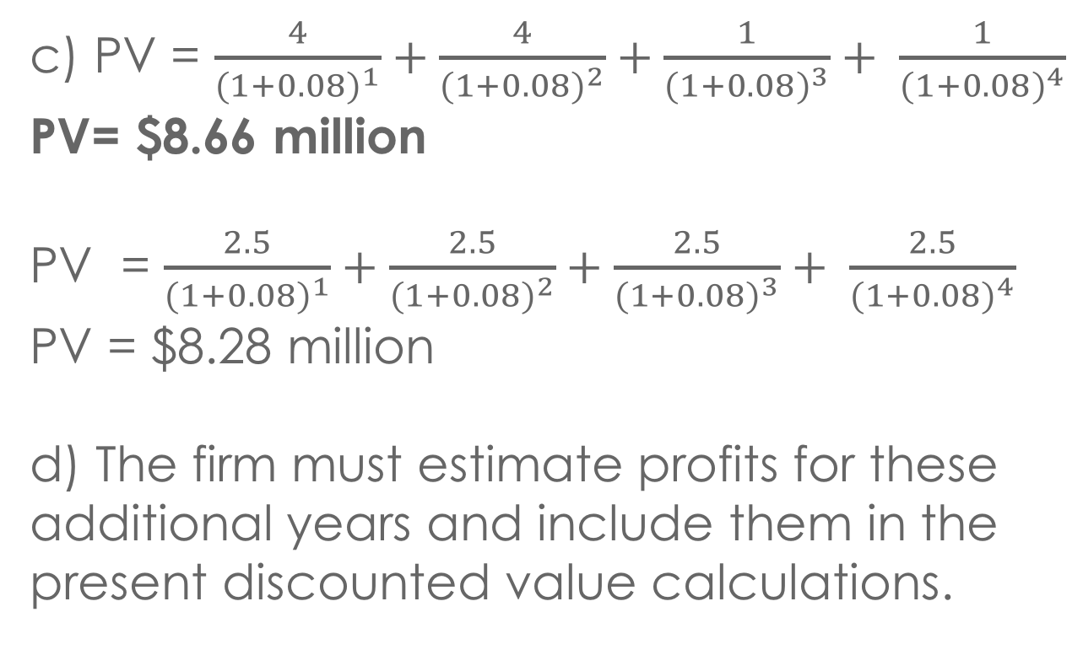
SOLUTION
c) PV = $\frac{4}{{(1+0.08)}^{1}}+\frac{4}{{(1+0.08)}^{2}}+\frac{1}{{(1+0.08)}^{3}}+ \frac{1}{{(1+0.08)}^{4}}$
PV= $8.66 million
PV = $\frac{2.5}{{(1+0.08)}^{1}}+\frac{2.5}{{(1+0.08)}^{2}}+\frac{2.5}{{(1+0.08)}^{3}}+ \frac{2.5}{{(1+0.08)}^{4}}$
PV = $8.28 million
d) The firm must estimate profits for these additional years and include them in the present discounted value calculations.

Slide 49
QUESTION 7
During a recession many people turn to pawnshops to raise cash. Because the collateral that people post is generally worth double what is lent, it generally can be sold at a profit. Pawnshops often charge high interest rates of 20 percent or more per month.
According to Goldman Sachs, pawnshops make 20% gross profit on defaulted loans and 205% interest on loans repaid.

Slide 50
QUESTION 7
a) In late 1991 there were about 8,000 pawnshops in the USA, according to American Business Information. This was much higher than in 1986, when the number was about 5,000. Indeed, in late 1991 alone the number jumped by about 1,000. Why did the number increase?

Slide 51
SOLUTION
a) High profits led to increased entry of more pawnshops, and 1990-1991 was a recession period, which could have led to an increase in the demand for pawnshops.

Slide 52
QUESTION 7
b) In a particular small city, do the pawnshops constitute a perfectly competitive industry? If not, what is the market structure of the industry?
c) Are there considerable barriers to entry in the pawnshop industry? (Note: A pawnshop can be opened for less than $125,000, but a number of states have tightened licensing requirements for pawnshops.)

Slide 53
SOLUTION
b) No, it can be considered an oligopoly. There are not a lot of pawnshops in general, and they are offering almost the same services.
c) $125K is generally not considered a high investment to start a business, but the licensing restriction can pose difficulties for people looking to enter the pawnshop market.

Slide 54
QUESTION 8
In 1996 dairy farmers, hurt by a decade of low milk prices, began reducing their herds. Subsequently Kenneth Hein, a Wisconsin farmer, said he was getting $16 per pound of milk rather than $12, which he had gotten earlier.
Why did the price increase?

Slide 55
SOLUTION
a) There is a decrease in supply. The curve shifts left → increase in Price

Slide 56
QUESTION 8
b) Dairy cattle are often fed corn. When Hein got $16 per 100 pounds of milk, he paid $ 5 a bushel for corn; but when he got $12 per pound, he paid $2.50 a bushel for corn. Does this mean that Hein made less money when the price of milk was $16 than when it was $12?

Slide 57
SOLUTION
b) Not necessarily. First, from the given information, his profit per 100 pounds of milk would be $11 when the price was $16, and his profit would be $9.50 per 100 pounds of milk when the price is $12. Also, farmer might change his optimal mix of inputs. There are also other costs to consider in producing milk.

Slide 58
QUESTION 9
The demand for diamonds is given by
P_{Z}=980 – 2Q_{Z}
The total cost (TCz) of the De Beers Company (a monopolist) is given by
TC_{Z}=100 + 50Q_{Z} + 0.5Q_{Z}²
Suppose the government could force De Beers to behave as if it were a perfect competitor – that is, via regulation, force the firm to price diamonds at marginal cost.

Slide 59
QUESTION 9
a) What is social welfare when De Beers acts as a single-price monopolist?

Slide 60
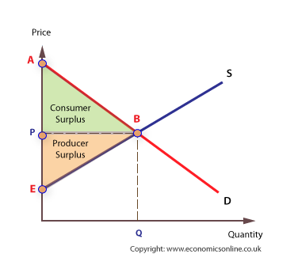
SOLUTION
980
a) MR=MC
980 – 4Q=50+Q
Q=186, P=$608
Social Welfare = Consumer Surplus (area of green triangle) + Producer Surplus (area of beige triangle)
608
186

Slide 61
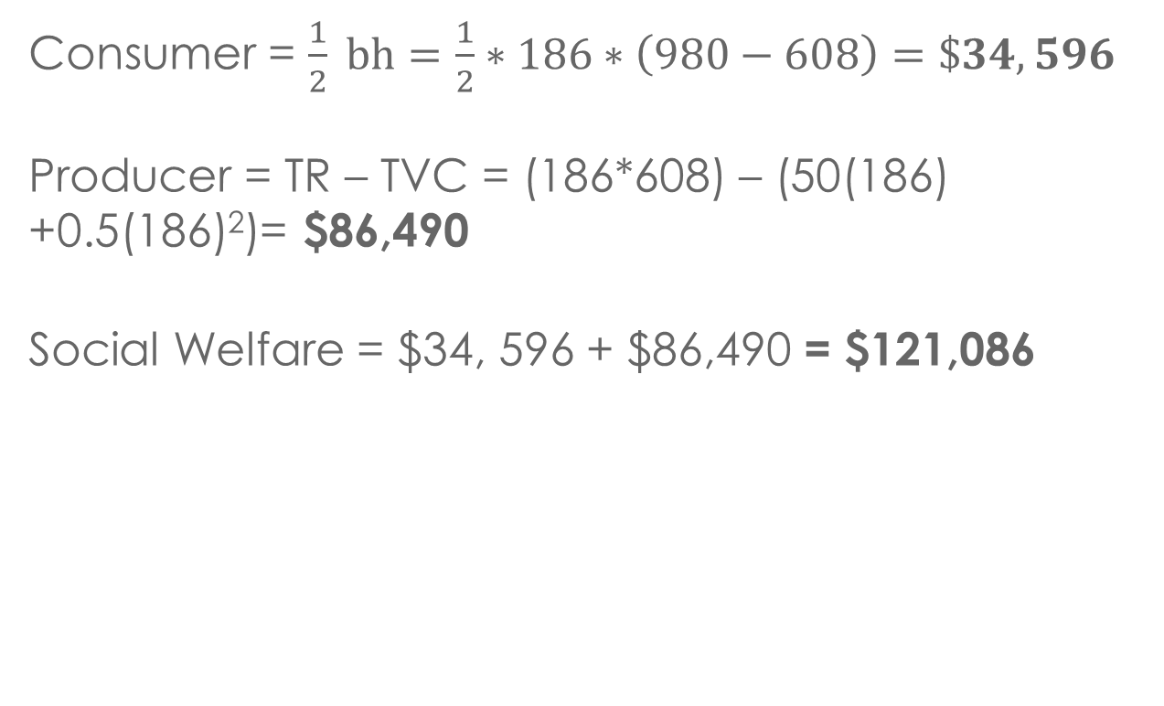
SOLUTION
Consumer = $\frac{1}{2} bh=\frac{1}{2}∗186∗\left(980−608\right)=\$34,596$
Producer = TR – TVC = (186*608) – (50(186) +0.5(186)²)= $86,490
Social Welfare = $34, 596 + $86,490 = $121,086

Slide 62
QUESTION 9
b) What is social welfare when De Beers acts as a perfect competitor?

Slide 63
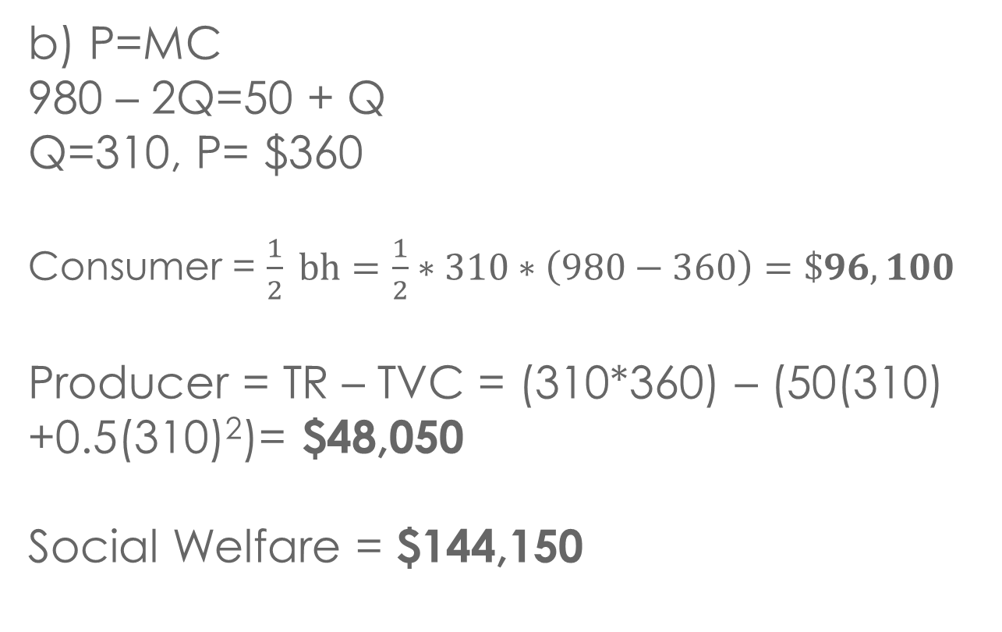
SOLUTION
980
b) P=MC
980 – 2Q=50 + Q
Q=310, P= $360
Consumer = $\frac{1}{2} bh=\frac{1}{2}∗310∗\left(980−360\right)=\$96,100$
Producer = TR – TVC = (310*360) – (50(310) +0.5(310)²)= $48,050
Social Welfare = $144,150
360
310

Slide 64
QUESTION 9
c) How much does social welfare increase when De Beers moves from monopoly to perfect competition?
Social Welfare increases by 144,150 – 121,086= $23,064

Slide 65
QUESTION 10
The Hassman Company produces two joint products, X and Y. The isocost curve corresponding to a total cost of $500,000 is
Qy=1000 – 10(Qx) – 5(Qx²)
The price of product X is 50 times that of product Y.
If the optimal output combination lies on the isocost curve, what is the optimal output of product X?

Slide 66
SOLUTION
Px=50(Py) Therefore (Px)/(Py)=50
dQ_{y}/dQ_{x}=-10-10Q_{x}= -50 = -(Px/Py), which then gives Q_{x}=4
The slope of the isorevenue curve must equal the slope of the isocost curve
i.e. The slope of the isorevenue curve must equal -1 x the price ratio

Slide 67
QUESTION 10
b) What is the optimal output of product Y?
c) Can you be sure that the optimal output combination lies on the isocost curve?

Slide 68
SOLUTION
b) Q_{y}=1000 – 10(4) -5(4)²=880.
c) No! You do not know the prices of the products. You just know the ratio of prices.

Slide 69
QUESTION 11
The McDermott Company estimates its average total cost to be $10 per unit of output when it produces 10,000 units, which it regards as 80 percent of capacity. Its goal is to earn 20 percent on its total investment, which is $250,000.
If the company uses cost-plus pricing, what price should it set?

Slide 70
SOLUTION
Profit Target = 0.2(250,000) = $50,000
TC=$10*10,000=$100,000
π=TR – TC
50,000=(10,000P) – 100,000
P=$15

Slide 71
QUESTION 11
b) Can it be sure of selling 10,000 units if it sets this price?
c) What are the arguments for and against a pricing policy of this sort?

Slide 72
SOLUTION
b) We do not know any information of the demand side so we can not determine.
c) Unless the markup bears the proper relationship to the price elasticity of demand, the firm probably is sacrificing profit, because they are not pricing the product where MR=MC

Slide 73
QUESTION 12
The Morrison Company produces tennis rackets, the marginal cost of a racket being $20. Because there are many substitutes for the firm’s rackets, the price elasticity of demand for its rackets equals about -2. In the relevant range of output, average variable cost is very close to marginal cost.

Slide 74
QUESTION 12
The president of the Company feels that cost-plus pricing is appropriate for his firm. He marks up average variable cost by 100% to set the price. Comment on this procedure.
Because of the heightened competition, the price elasticity of demand for the firm’s rackets increase to -3. The president continues to use the same cost-plus pricing formula. Comment on adequacy.

Slide 75
SOLUTION
a) -1/(η+1)=-1/(-2+1)=100% → correct markup
b) -1/(η+1)=-1/(-3+1)=50%.
Markup should change to 50% to maximize profit.

Slide 76
QUESTION 13
The Backus Corporation makes two products, X and Y. For every unit of good X that the firm produces, it produces two units of goods Y. Backus’s total cost function is
TC = 500 + 3Q +9Q²
(where each unit contains one unit of good X and two units of good Y)
The demand curves for the firm’s two products are
P_{x}= 400-Q_{x}
P_{y}=300-3Q_{y}

Slide 77
QUESTION 13
How much of each product should the Backes Corporation produce and sell per period?
What price should it charge for each product?

Slide 78
SOLUTION
a) TR=P_{x}Q_{x} + P_{y}Q_{y}=(400 - Q_{x})Q_{x} +(300 - 3Q_{y})Q_{y}
Since Q_{y}=2Q_{x}:
TR=(400 - Q_{x})Q_{x} +(600 - 6Q_{x})2Q_{x} =1000Q_{x} - 13Q_{x}²
π=1000Q_{x} - 13Q_{x}² – 500 - 3 Q_{x} - 9Q_{x}²
dπ/dQ_{x}=997 - 44Q_{x}
Q_{x}=22.66 units
Q_{y}=45.32 units
b) Px=400 – 22.66=$377.34
Py=300 – 3(45.32)=$164.04

Slide 79
APPENDIX

Slide 80
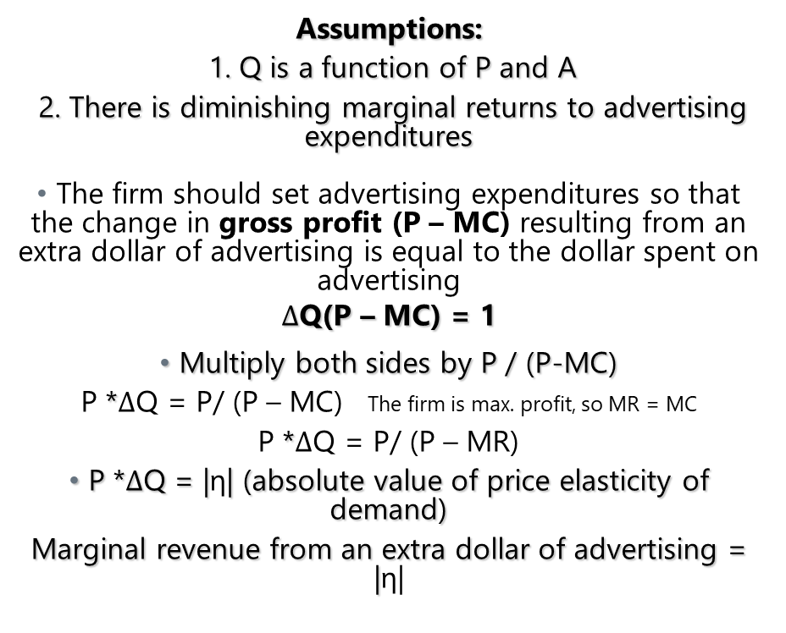
Optimal Advertising Rule
Assumptions:
1. Q is a function of P and A
2. There is diminishing marginal returns to advertising expenditures
The firm should set advertising expenditures so that the change in gross profit (P – MC) resulting from an extra dollar of advertising is equal to the dollar spent on advertising
$∆$Q(P – MC) = 1
Multiply both sides by P / (P-MC)
P *$∆$Q = P/ (P – MC) The firm is max. profit, so MR = MC
P *$∆$Q = P/ (P – MR)
P *$∆$Q = |η| (absolute value of price elasticity of demand)
Marginal revenue from an extra dollar of advertising = |η|

